Slide 1
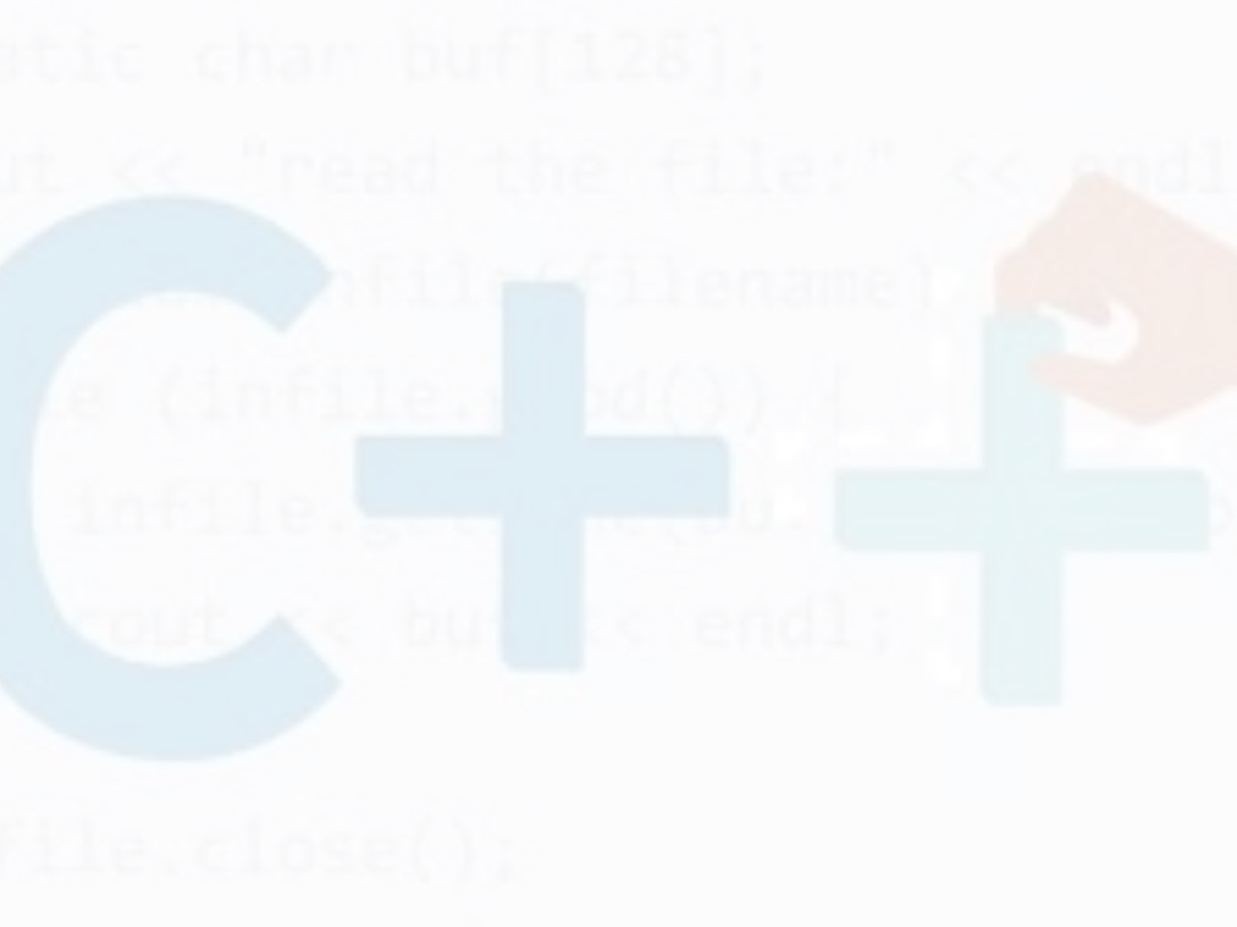
Module 2 Part I: Introduction to C ++
What will be covered
Introduction
Features of C
Application Areas
Application or Uses of C++
C++ Program development Life Cycle
Translators and Compiler installation
C++ program Creation Process
Typical C++ Development Environment

Slide 2
Definition of C++
C++ is a multi-paradigm programming language that supports object-oriented programming (OOP), created by Bjarne Stroustrup in 1983 at Bell Labs, C++ is an extension(superset) of C programming and the programs are written in C language can run in C++ compilers.

Slide 3
History of C++
C++ development began in 1979, four years before its release, and it did not start with the name C++; Its first name was C with classes. In the late part of 1983, C with Classes was first used for AT&T's internal programming needs.
Its name was changed to C++ later in the same year.
C++ was not released commercially until the late part of 1985.
C++ implements data abstraction using a concept called classes, along with other features to allow object-oriented programming and is considered a high-level language. Classes help programmers with the organization of their code. They can also be beneficial in assisting programmers to avoid mistakes.
The original C++ compiler, called Cfront, was written in the C++ programming language. C++ compilation is considered efficient and fast. Its speed can be attributed to its high-level features in conjunction with its low-level components. When compared

Slide 4
C++ Language Features
Object-oriented: C++ is an object-oriented programming language. This means that the focus is on “objects” and manipulations around these objects. Information about how these manipulations work is abstracted out from the consumer of the object.
Rich library support: Through C++ Standard Template Library (STL) many functions are available that help in quickly writing code. For instance, there are standard libraries for various containers like sets, maps, hash tables, etc.
Speed: C++ is the preferred choice when latency is a critical metric. The compilation, as well as the execution time of a C++ program, is much faster than most other general purpose programming languages.
Compiled: A C++ code has to be first compiled into low-level code and then executed, unlike interpreted programming languages where no compilation is needed.

Slide 5
C++ features
Pointer Support: C++ also supports pointers which are widely used in programming and are often not available in several programming languages.
It is one of the most important programming languages because almost all the programs/systems that you use have some or the other part of the codebase that is written in C/C++. Be it Windows, be it the photo editing software, be it your favorite game, be it your web browser, C++ plays an integral role in almost all applications that we use.

Slide 6
Uses/Applications of C++ Language
Operating Systems: Be it Microsoft Windows or Mac OSX or Linux
Browsers:.
Banking Applications: One.
Cloud/Distributed Systems
Databases such as Postgres and MySQL are written in C++ Embedded Systems: Various embedded systems like medical machines, smartwatches, etc. use C++ as the primary programming language
Embedded system means things that are automobiles, robotics, and appliances

Slide 7
Applications of C++
C++ is used by programmers to create computer software.
It is used to create general systems software, drivers for various computer devices, software for servers and software for specific applications and also widely used in the creation of video games.
C++ is mostly used to write device driver programs, system software, and applications that depend on direct hardware manipulation under real-time constraints.

Slide 8
C++ Program Development Life Cycle
To develop a program using any programming language, we follow a sequence of steps.The program development life cycle is a set of steps or phases that are used to develop a program in any programming language. Generally, program development life cycle contains 6 phases, they are as follows
Problem Definition
Problem Analysis
Algorithm Development
Coding & Documentation
Testing & Debugging
Maintenance
.

Slide 9
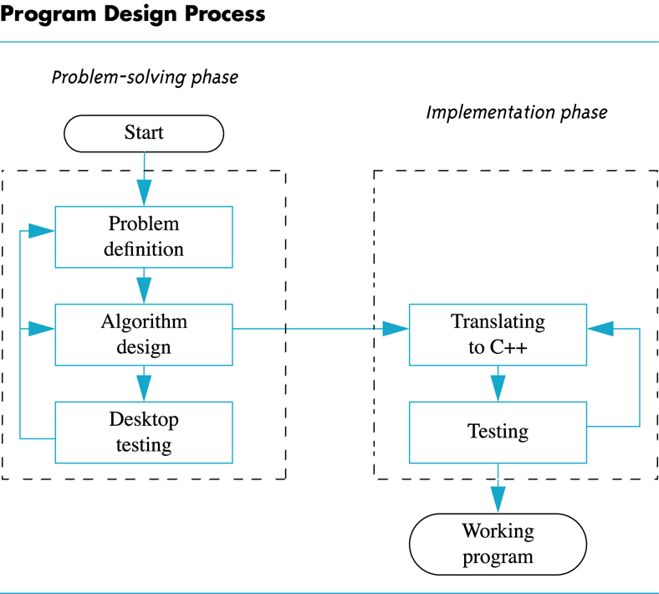
Program Design Process

Slide 10
Problem Definition
In this phase, programmer defines the problem statement and we decide the boundaries of the problem. In this phase we need to understand the problem statement, what is our requirement, what should be the output of the problem solution. These are defined in this first phase of the program development life cycle.
Problem Analysis
In phase 2, programmer determine the requirements like variables, functions, etc. to solve the problem. That means we gather the required resources to solve the problem defined in the problem definition phase. We also determine the bounds of the solution

Slide 11
Algorithm Development
During this phase, the programmer develops a step by step procedure to solve the problem using the specification given in the previous phase. This phase is very important for program development. That means we write the solution in step by step statements
Coding & Documentation
During this phase the programmer uses a programming language to write or implement actual programming instructions for the steps defined in the previous phase. In this phase, A programmer constructs actual program. That means writing the (codes) program to solve the given problem using programming languages like C, C++, Java etc.

Slide 12
5. Testing & Debugging
During this phase, A programmer checks whether the code written in previous step is solving the specified problem or not. That means to test the program and find out whether it is solving the problem for various input data values or not. Testing is done to find whether a program is providing the desired output or not.
6. Maintenance
During this phase, the program is actively used by the users. If any enhancements found in this phase, all the phases are to be repeated again to make the enhancements. That means in this phase, the solution (program) is used by the end user. If the user encounters any problem or wants any enhancement, then we need to repeat all the phases from the starting, so that the encountered problem is solved or enhancement is added

Slide 13
Languange translators
Language translators are system programs that convert assembly language and high-level language into the machine language.
The computer does not understand assembly languages or high-level languages. Computers work in machine code or machine language.
Examples
Assemblers
Compilers
Interpreters

Slide 14

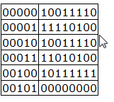
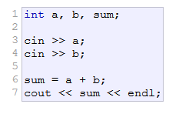
Why need of Langauage Transaltors
A single instruction to a computer could look like this:
A particular computer's machine language program that allows a user to input two numbers, adds the two numbers together, and displays the total could include these machine code instructions:
Programming a computer directly in machine language using only ones and zeros is very tedious and error prone.
This is a portion of code written in C++ that accomplishes the exact same purpose:
.

Slide 15
Because a computer can only understand machine language and humans wish to write in high level languages, high level languages have to be re-written (translated) into machine language at some point.
This is done by special programs called translators . These are compilers, interpreters, or assemblers that are built into the various programming applications.
C++ is designed to be a compiled language, meaning that it is generally translated into machine language that can be understood directly by the system, making the generated program highly efficient.
For that, a set of tools are needed, known as the development toolchain, whose core are a compiler and its linker.

Slide 16
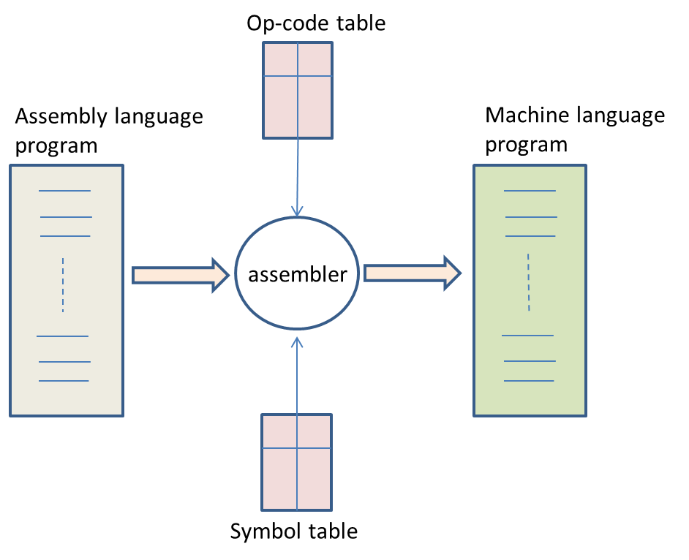
Asssembler
An assembler, is utility program used to translate assembly language statements into the target computer's machine code. An assembler converts the assembly language program into an equivalent machine executable program
The assembler performs a more or less isomorphic translation (a one-to-one mapping) from mnemonic statements into machine instructions and data.
name.

Slide 17
The Compiler
A compiler can be precisely defined as a program that translates a program written in high-level language into machine language. A Compiler is a program that converts (compiles it) the entire code source into machine language at one time before the computer can run the program at a later time.
A compiler is a computer program that transforms humanly readable (programming language) source code into another computer language (binary) code
In simple terms, Compiler takes the code that you wrote and turned in to the binary code that the computer can understand.
While compiling the source code into machine code, the compiler checks if syntax is properly written by the programmer and enables the programmer to debug the program
A compiler is a much more complex program than an assembler. It does not only translates the source code instructions into machine code but also maps the data structures of the HLL program onto the linear memory of the underlying hardware.

Slide 18
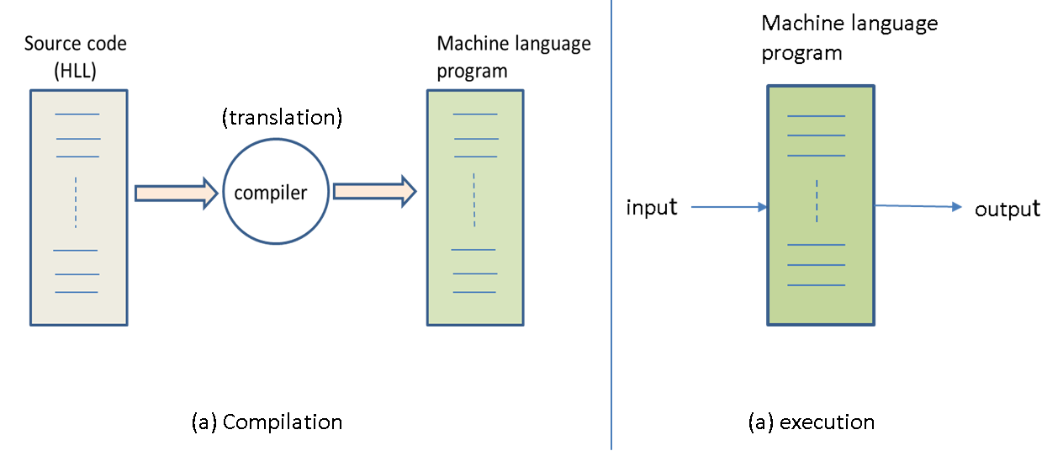
HLL instrcutions(codes) are English-like, a statement written in this language such as C++ is not understandable to the machine. A high-level language translator is called a compiler. The compiler takes the source code as input and translates it line by line into machine code.

Slide 19
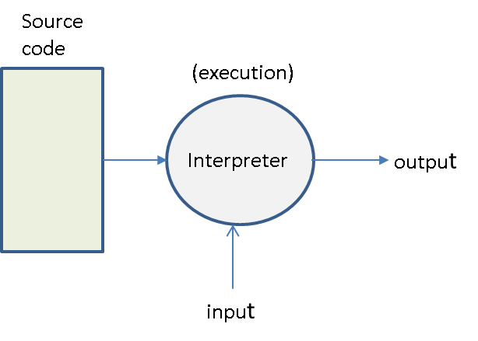
The Concept of Interpretation
The interpreters are programs that translates the high level program code one statement at a time, that is, it reads a code statement, converts it to one or more machine language instructions, and then executes the instruction before moving translating the next code statement in the program. If there is any error in the statement, the programmer can correct the error before the interpreter evaluates the next statement. An interpreter is a simple program. It does not translate the source code into machine code. In fact, it reads the source code program line by line and executes it (see Fig. 6.5). Therefore, an interpreter is also called a program execution environment
.
Interpreters are slower than Compilers because interpreters convert a statement at a time and runs it before moving to the next line

Slide 20
C++ Compiler Installation on windows
Before you start learning and writing codes in C++ programming. You need to install the following on your Computers;
Text editor such as Notepad, sublime text to be used to write source code and C++ compiler software such as Intel C++ Compiler, MinGW, Clang, The Borland C++ Compiler 5.5 etc
For the purpose of this class, we shall opt for IDEs as Ideal software for developing programs in C++ Language. The easiest way for beginners to compile C++ programs is by using an Integrated Development Environment (IDE).
An Integrated Development Environment (IDE) is a packaged interface that provides a suite of tools and features that aid development. It is basically a complete package that offers a code editor, a debugging tool and an automated tool.
An IDE generally integrates several development tools, including a text editor and tools to compile programs directly from it.

Slide 21
Available C++ Compliers for diff OS
For Windows:
Code::Blocks
Borland C++
Microsoft Visual C++
Turbo C++
Dev-C++
C++ Builder
Microsoft Visual C++
Eclipse IDE
NetBeans IDE
For Linux:
g++ is a C++ compiler that comes with most *nix distributions.
For Mac OS:
Apple XCode
C++ Code::Block

Slide 22
The Program Creation Process
Computers execute binary instructions. These binary instructions are known as machine instructions or machine code. It is difficult to program in machine code and early computer pioneers soon developed an easier way to write programs. The program creation process consists of the following steps:
Step 1 – Write the program in a computer language humans can read and understand (like C++),
Step 2 – Save the programs in text files. Programs can be a few lines long and reside in one file or can consist of many millions of lines of code and span thousands of files,
Step 3 – Run the source code files through a program called a compiler to generate object code for the target computer,
Step 4 – Run the object files through a program called a linker to produce an executable image

Slide 23
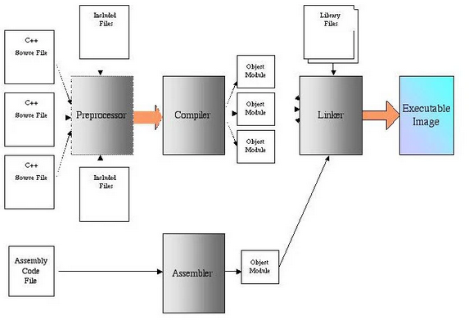

Slide 24
The Program Creation Process
Two interesting points to note in figure above. First, C++ adds a preprocessing step to the program creation process. The C++ preprocessor acts upon special instructions that can be contained in the C++ source code. These special preprocessor instructions are called preprocessor directives. These are #include, #ifndef, #define, and #endif.
The second item of interest is the assembly code file and assembler step shown at the bottom. Program routines can be created in other languages and compiled into object modules and then later linked with object modules created with C++. This is often referred to as mixed-language programming.
Translating the Code for the Computer
While you now understand “My First C++ Program” code, the computer won’t. Computers don’t understand C++ or any other programming language. They understand only machine language.

Slide 25
Three programs are used to translate your source code into an executable file that the computer can run. These programs are, in their order of appearance:
Preprocessor
Compiler
Linker

Slide 26
Preprocessor
The preprocessor is a program that scans the source code for preprocessor directives such as include directives. The preprocessor inserts into the source code all files included by the include directives.
In this example, the iostream standard library file is included by an include directive. Therefore, the preprocessor directive inserts the contents of that standard library file, including its definition of the cout object, into the source code file.

Slide 27
Compiler
The compiler is another program that translates the preprocessed source code (the source code after the insertions made by the preprocessor) into corresponding machine language instructions, which are stored in a separate file, called an object file, having an .obj extension. There are different compilers for different programming languages, but the purpose of the compiler is essentially the same, the translation of a programming language into machine language, no matter which programming language is involved.

Slide 28
The compiler can understand your code and translate it into machine language only if your code is in the proper syntax for that programming language. C++, like other programming languages, and indeed most human languages, has rules for the spelling of words and for the grammar of statements. If there is a syntax error, then the compiler cannot translate your code into machine language instructions, and instead will call your attention to the syntax errors. Thus, in a sense, the compiler acts as a spell checker and grammar checker.

Slide 29
Linker
While the object file has machine language instructions, the computer cannot run the object file as a program. The reason is that C++ also needs to use another code library, called the run-time library, for common operations, such as the translation of keyboard input or the ability to interact with external hardware such as the monitor to display a message.
The linker is a third program that combines the object file with the necessary parts of the run-time library. The result is the creation of an executable file with an .exe extension. The computer runs this file to display “Hello World!” on the screen.

Slide 30
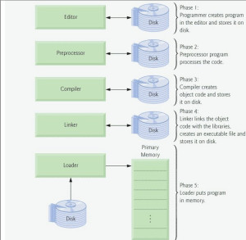
Typical C++ Development Environment
Let’s consider the steps in creating and executing a C++ application using a C++ development environment (illustrated in Figure above). C++ systems generally consist of three parts: a program development environment, the language and the C++ Standard Library. C++ programs typically go through six phases: edit, preprocess, compile, link, load and execute.

Slide 31
Phase 1: Creating a Program
Phase 1 consists of editing a file with an editor program (normally known simply as an editor). You type a C++ program (typically referred to as source code) using the editor, make any necessary corrections and save the program on a secondary storage device, such as your hard drive. C++ source code file names often end with the .cpp, .cxx, .cc or .C extensions (note that C is in uppercase) which indicate that a file contains C++ source code. See the documentation for your C++ environment for more information on file-name extensions.

Slide 32
Phases 2 and 3: Preprocessing and Compiling a C++ Program
In phase 2, the programmer gives the command to compile the program. In a C++ system, a preprocessor program executes automatically before the compiler’s translation phase begins (so we call preprocessing phase 2 and compiling phase 3). The C++ preprocessor obeys commands called preprocessor directives, which indicate that certain manipulations are to be performed on the program before compilation. These manipulations usually include other text files to be compiled and perform various text replacements.

Slide 33
Phase 4: Linking
Phase 4 is called linking. C++ programs typically contain references to functions and data defined elsewhere, such as in the standard libraries or in the private libraries of groups of programmers working on a particular project. The object code produced by the C++ compiler typically contains “holes” due to these missing parts. A linker links the object code with the code for the missing functions to produce an executable image (with no missing pieces). If the program compiles and links correctly, an executable image is produced.

Slide 34
Phase 5: Loading
Phase 5 is called loading. Before a program can be executed, it must first be placed in memory. This is done by the loader, which takes the executable image from disk and transfers it to memory. Additional components from shared libraries that support the program are also loaded.
Phase 6: Execution
Finally, the computer, under the control of its CPU, executes the program one instruction at a time.
Programs do not always work on the first try. Each of the preceding phases can fail because of various errors. For example, an executing program might attempt to divide by zero (an illegal operation for whole-number arithmetic in C++). This would cause the C++ program to display an error message. If this occurs, you would have to return to phase-1 for editing, make the necessary corrections and proceed through the remaining phases again to determine that the corrections fix the problem(s)

